Slide 1
Save the air with the Arduino-Navigation-Service
No more polution through particulate matter

Slide 2
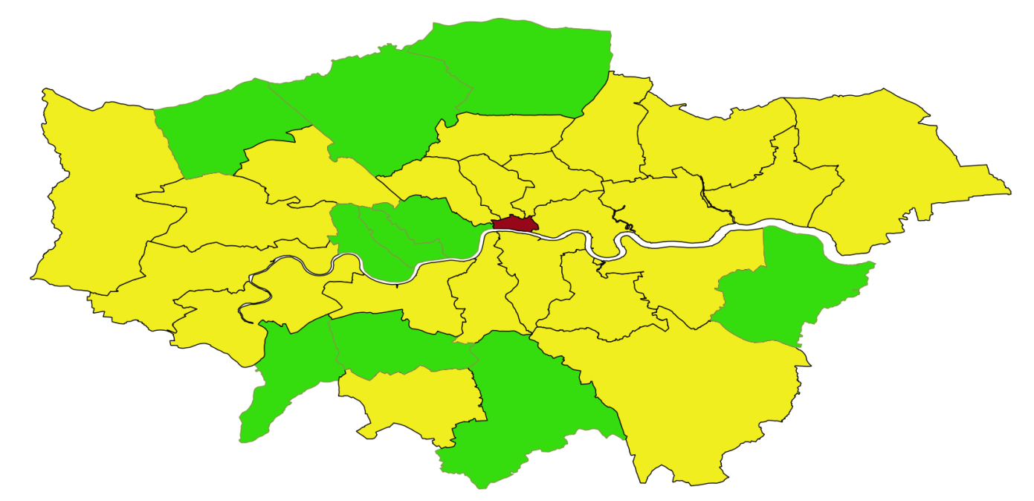
We drive every day all the time…
… and pollution really isn‘t good for us.
Take London for an instance:

Slide 3

Instead of traveling From A to B
A
B

Slide 4
Traveling From A to B
A
B

Slide 5
Save the air with the Arduino:
A navigational System that considers pollution
Smart traveling routs are suggested
Pollution reduction in troubled areas
Healtier community and urban life

Slide 6
Building it
QGIS
OpenStreetMap
Pollution information (LondonAir Data)
Python
Arduino
GitHub
Firmata

Slide 7
DEMO Case
Map of London
Pollution per block in London
Neighbouring blocks in London
Optimizing the shortest route to an environment friendly route
→ Driving healty

Slide 8
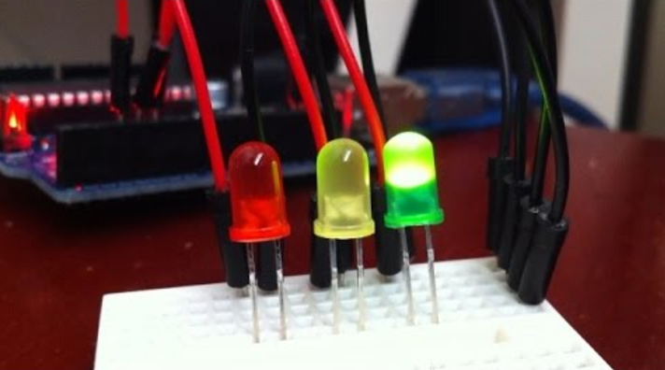
DEMO Case
In the Car…
…Arduino states the polltuion level of the road you currently are on
…Arduino tells you which way to go
„please turn onto High Hill Road“

